Slide 1
Telehealth as a Response to COVID-19
INFM600
Will Kraft, Srinidhi Nag, Gloria Nzeka, Kelin West

Slide 2
The Problem
Due to the coronavirus pandemic, individuals are not seeking medical care they may need
People are hesitant to visit medical facilities for many reasons
Lack of transportation
Fear of infection
Fear of spreading infection
Telehealth has emerged as a definite alternative, but many are left unaware of this solution
Notes:
Srin

Slide 3
Background Information
According to the CDC, an average of 40% of Americans were delaying medical care as a result of the pandemic
The number of visits to ambulatory practices was down nearly 60% in April and has only been slowly increasing since
Notes:
Srin
Source: Ateev Mehrotra et al., “The Impact of the COVID-19 Pandemic on Outpatient Visits: A Rebound Emerges,” To the Point (blog), Commonwealth Fund, May 19, 2020. https://doi.org/10.26099/ds9e-jm36

Slide 4
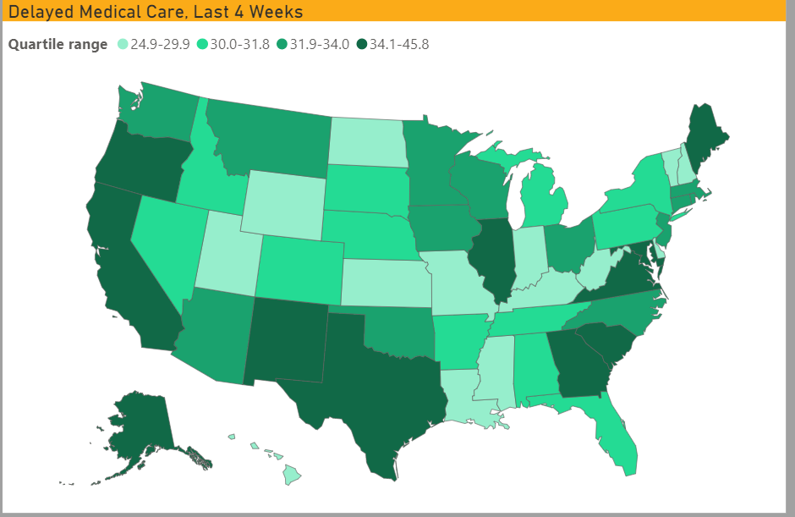
CDC: Delayed Medical Care by State
Notes:
Srin

Slide 5
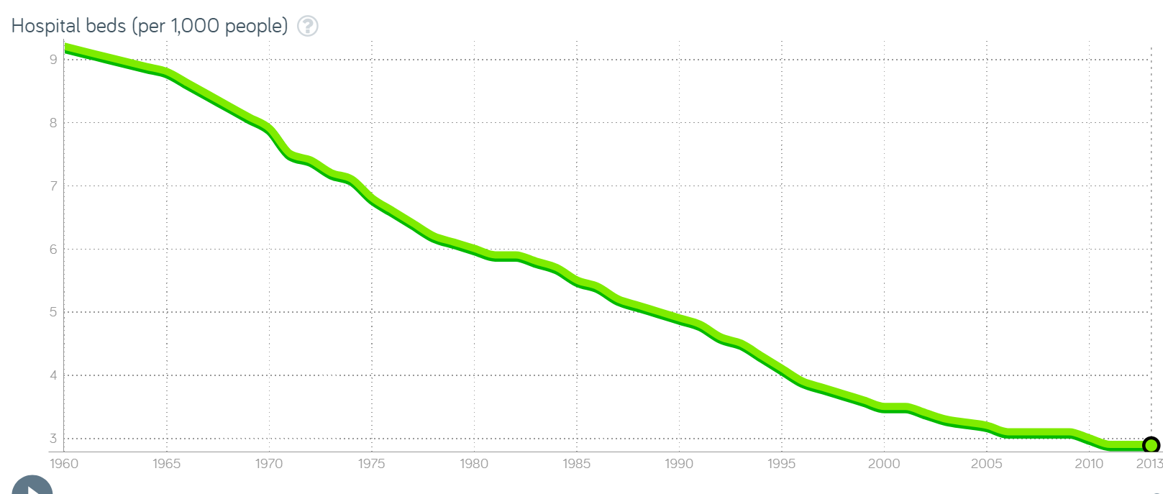
Gapminder: U.S. Hospital Beds per 1000 people
Notes:
Srin

Slide 6
Interviews
We interviewed different individuals to gauge their understanding of telehealth opportunities, as well as whether or not they have been actively accessing healthcare since the beginning of the coronavirus pandemic
Many individuals admitted to cancelling yearly physicals and bi-yearly dental cleanings
Medical visits were limited only to emergencies
Reasonings:
Fear of exposure to virus
Reduced income as a result of the pandemic
Notes:
Gloria

Slide 7
Our Potential Solution
Providing guidance and help to those unaware of telehealth opportunities
Promoting awareness of telehealth for the future even beyond the COVID-19 lockdown
Advertisement for and education of the services available to individuals will improve health literacy, which will encourage health-promoting behaviors
In this case, we wish to:
Inform and encourage individuals to explore their telehealth options
Encourage individuals to seek care when needed, in-person or otherwise
Educate individuals on how they can seek telehealth care
Notes:
Gloria

Slide 8
Solution Demo

Slide 9
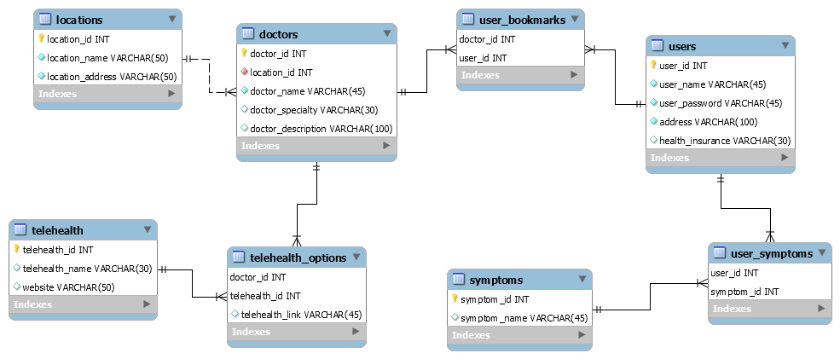
ERD
Notes:
Will

Slide 10
Solution Efficacy
Health literacy promotes positive health behaviors
Individuals are more likely to access care if they can do it from the safety of their homes
This solution would be appealing because it will not cost individuals more than if they were visiting a doctor pre-pandemic
Most doctors do not have any additional fees for virtual appointments
Giving patients the opportunity to access all resources and tools in one place simplifies the process, encouraging continued use
Notes:
Kelin

Slide 11
Conclusion
An average of 40% of Americans are delaying medical care as a result of COVID-19
Lack of transportation
Fear of infection
Fear of spreading infection
Our platform promotes health literacy and encourages health-conscious decisions
Ease of use for varying levels of tech-proficiency
All resources and tools in one location
Keeps users safe by allowing them to meet with medical professionals from the comfort of their home, unless medically necessary to meet in person
Notes:
Kelin

Slide 12
Thank You.
Happy Holidays!
Notes:
Kelin

